Slide 1

WHICH ACTUATOR IS BEST FOR CONTROL VALVE?
Process instrumentation
Group no. 2

Slide 2

Agenda
What is Control Valve?
Types of Valve Operations
Types of Valve Actuators
Valve Actuator Functions
Considerations in choosing Valve
Observations
Conclusion

Slide 3
Control Valve^{[2]}
It is a valve used to control fluid flow
It is done by varying the flow passage
Helps us to control direction and flow rate of fluid
It controls process quantities pressure, Temperature, and liquid level

Slide 4
TYPES OF VALVE OPERATIONS
Multiturn Operation:
Require Multiple turning operation to act
Gives precise control
Operation is slow
E.g.
Gate Valve, Globe Valve
Rotary (Quarter Turn) Operation
It require a 90-degree operation at specific torque
Quick opening and closing
Less precise but fast
E.g.
Ball valve, Butterfly valve, Plug valve Etc.

Slide 5
TYPES OF VALVE ACTUATORS[1]
Pneumatic Actuators (Quarter Turn):
When electricity isn’t readily available
Precision is not that important
Require compressor to store air or hydraulic oil and need more space
Pneumatic and hydraulic Actuator (Multiturn):
Gate valve or Globe valve
Pneumatic / Hydraulic motors are often used

Slide 6
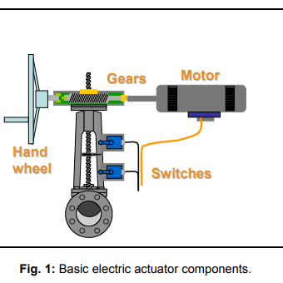
TYPES OF VALVE ACTUATORS [2]
Electric Actuators:
Quick and precise operation
Require 1 or 3 phase electric supply
Valve driven by motor and gear assembly
Most reliable and used in industry
E.g., Motor
Manual Actuators:
Simplest form of actuators operated my human.
E.g., Lever, Switch, Wheel

Slide 7
Important Valve Actuator Functions^{[1]}
Moving valve precisely closer to appropriate setpoint or location
Holding the valve to given position
Seating the valve with enough torque to meet desired shutoff specifications
Having a failure mode
Providing the right operating speed
Power / Pressure Requirements

Slide 8
Considerations in choosing a valve^{[1]}
Compatibility
01
Temperature Range
02
Area to work with
03
Space available
04
Application to work with
05
Budget
07
Safety
06

Slide 9
Observation/Remarks
Pneumatic Actuators
Expensive
Stored at Clean dust free place
Require Compressor to store and fill air
Hydraulic Actuators
Expensive
Oil Leakage
Heavy Applications
Storage and refilling
Electric Actuators
Less expensive
Uninterrupted Power Supply
Maintenance
High Accuracy and precision

Slide 10

Conclusion
Electric Actuators
High accuracy and precision
No external affecting factor
Less space
Easy operation and feedback
Gives specific and controllable output

Slide 11
References
^{[1]}https://www.mpofcinci.com/blog/how-to-select-a-valve-actuator/
^{[2]}https://en.wikipedia.org/wiki/Control_valve
^{[3]}http://www.flowone.co.kr/community/types-of-valves-multi-turn-valve-quarter-turn-valve/
^{[4]}https://www.indelac.com/blog/bid/327474/how-to-select-an-actuator-part-1-pneumatic-vs-electric

Slide 12

Thank You
Presentation by
Aditya Rotithor (27)
Adarsh Sapkal (32)
Shaunak Deshpande (39)
Shrawani Shinde (46)

